Slide 1

Wine Quality Analysis Project
End-to-end data science case study exploring physicochemical drivers of wine quality across +5,000 sample records of red and white wine. We identify chemical correlations, segment wines by profile, and set benchmarks for decision-making on wine quality production.

Slide 2
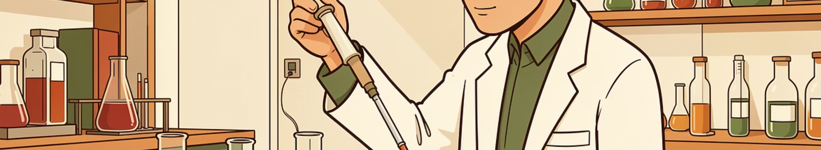
Project Objectives
Analyze
Segment
Uncover chemical features that impact expert and consumer quality ratings.
Cluster wines by chemical profile and relate segments to quality scores.
Benchmark
Define actionable chemical thresholds winemakers can target.

Slide 3

Key Datasets
Datasets from the UCI Machine Learning Repository containing 12 physicochemical features and expert quality ratings for thousands of red and white wines.
Red Wine: winequality-red.csv
White Wine: winequality-white.csv

Slide 4

Dataset Overview
Dataset Features
fixed acidity
volatile acidity
citric acid
residual sugar
chlorides
free sulfur dioxide
total sulfur dioxide
density
pH
sulphates
alcohol
quality
For practical purposes, the original quality variable was renamed to consumer_score. Although this score represents the median evaluation of expert sommeliers, it is treated in this study as a proxy for aggregated consumer preference, following the assumption that expert quality assessments are aligned with general consumer perception.

Slide 5




Core Techniques & Workflow
Data Cleaning & EDA
Correlation & Insights
Dimensionality Reduction
pandas, numpy, seaborn, matplotlib — distributions, missing values, outliers.
Feature relationships analyzed in chemistry context.
PCA to summarize chemistry into interpretable axes.
Clustering
k-Means, silhouette, elbow method to segment wines.

Slide 6
Data Cleaning
Initial examination of the wine datasets revealed a high level of data integrity, with key observations regarding missing values and duplicate entries.
No Missing Values (NaN)
Duplicate Entries Identified
Both red and white wine datasets were complete, with no NaN values detected across any chemical features or quality scores.
While no missing data was found, a significant number of duplicate rows were present: 240 in red wine and 937 in white wine datasets.
These duplicates are not indicative of data entry errors but rather represent instances of wines sharing identical chemical profiles and consumer quality ratings.
Given that these profiles are valid and contribute to the overall statistical representation of wine characteristics, they were intentionally retained in the datasets.

Slide 7


Exploratory Data Analysis (EDA)
Quality Score Distribution
Red Wine
White Wine
Count of 1599 testing wine records (rows).
~83% score 5–6 (acceptable to good).
Only ~1% reach very high scores (7–9).
Count of 4898 testing records (rows).
~75% score 5–6 (acceptable to good).
4% reach 7–9 (slightly higher than red).

Slide 8

Correlation With Consumer Score Analysis (Spearman)
Spearman correlations reveal monotonic relationships between chemistry and consumer scores — useful for ordinal score interpretation.
Red Wine — Key Correlates
Alcohol & sulphates: positive with consumer score. Volatile acidity, chlorides, total SO₂: negative.
White Wine — Key Correlates
Alcohol & pH: positive. Density, chlorides, total SO₂: strong negatives.
Interpretation ties chemistry to perception: alcohol often signals ripeness and body; volatile acidity and chlorides associate with lower perceived quality.

Slide 9
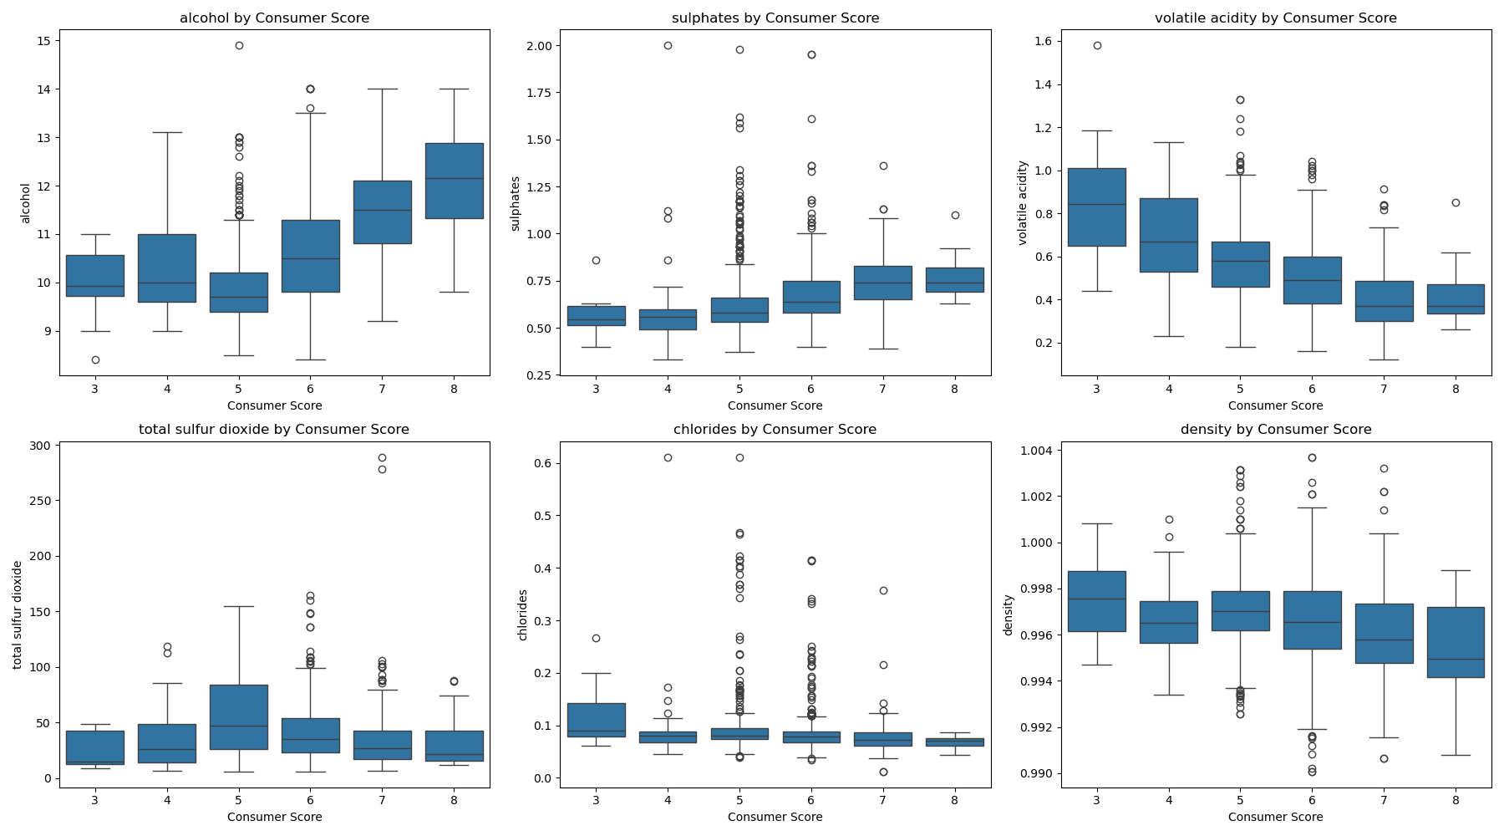
Distributions of Highly Correlated Variables with Consumer Scores
.
Boxplots Red:
Alcohol and sulphates increase with score; volatile acidity, chlorides, density decrease as quality rises.

Slide 10
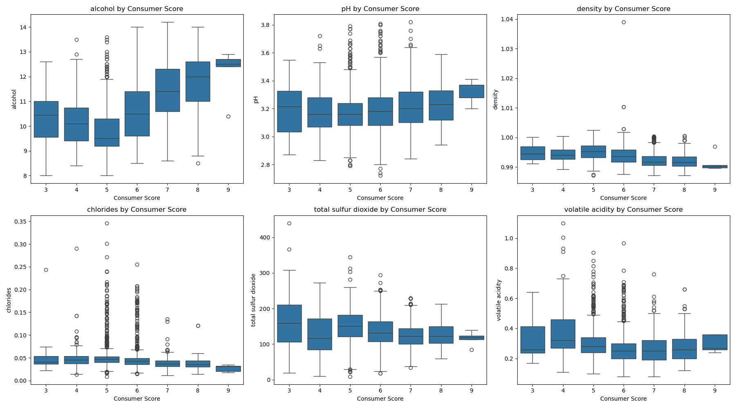
Distributions of Highly Correlated Variables with Consumer Scores
.
Boxplots White:
Alcohol and pH rise with higher scores; density and chlorides peak in low-quality wines.

Slide 11
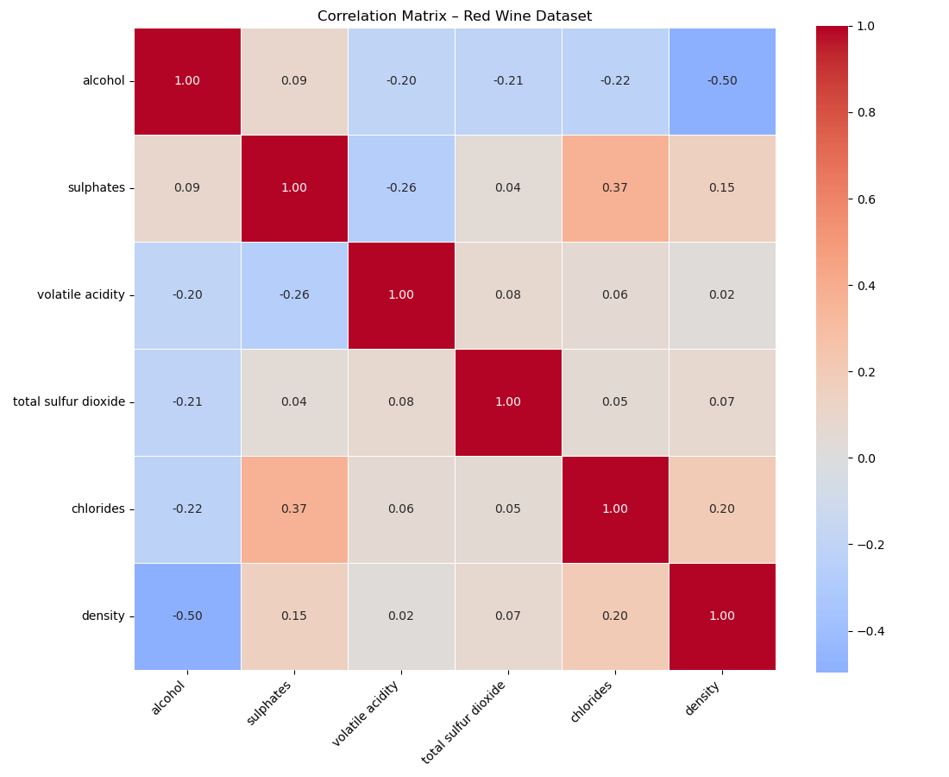
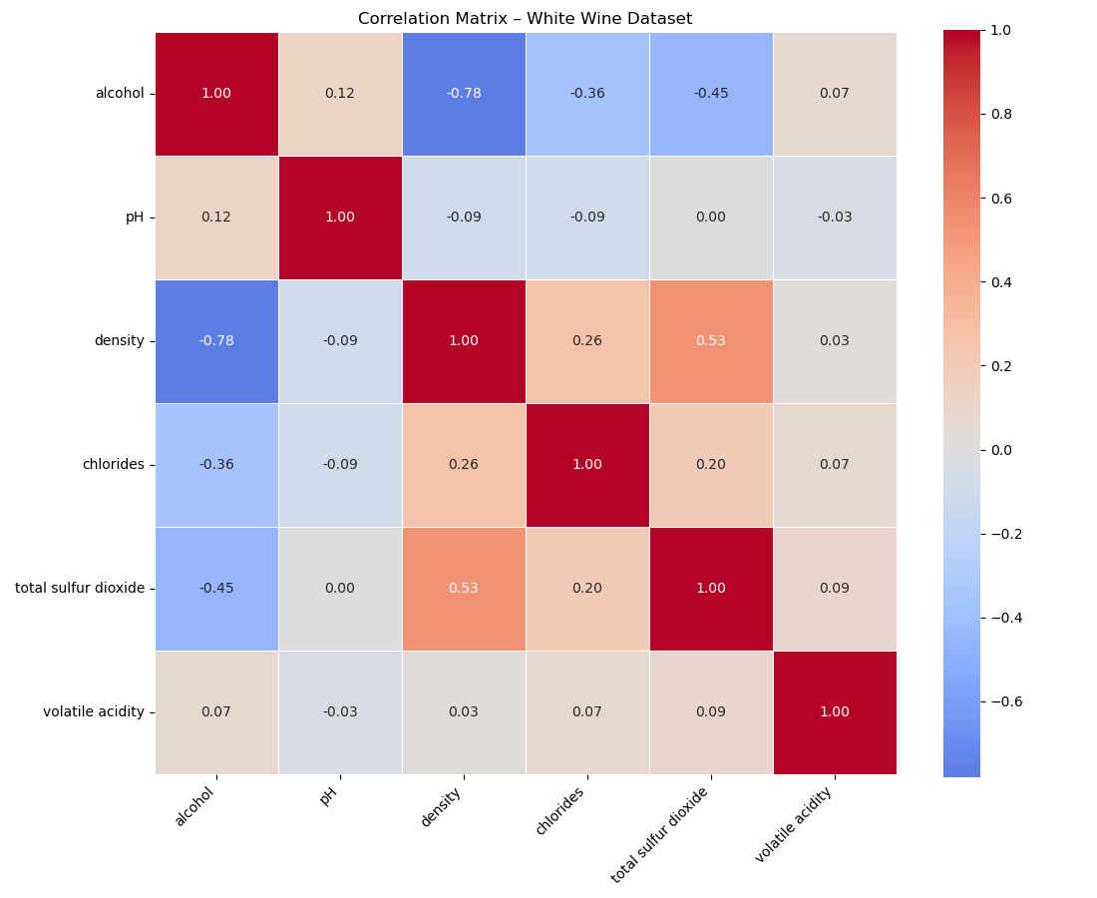
Correlation Between Chemical Variables
Red:
Alcohol-negative relationship with most variables, while density keep positive trend with minerals and ions.
White:
Even negative relationship with alcohol, while density keep positive trend with minerals and ions.

Slide 12
Correlation Analysis & Chemical Summary Insights
Variable
Typical Correlation
Explanation (Red & White)
Alcohol
Strong Negative (density)
Ethanol lowers density; proxy for ripeness
Sulphates
Slight Positive (chlorides/density)
Added for stabilization; tracks with mineral ions
Volatile Acidity
Negative (alcohol/sulphates)
Indicates microbial/fermentation stress
Total SO₂
Weak
Reflects winemaker additions more than chemistry
Chlorides
Negative
Reflects soil/mineral/underripeness
pH (White only)
Weak/Complex
Controlled via acidification in white wines
Density
Strong Negative (alcohol)
Alcohol and dissolved solids dominate density in whites

Slide 13
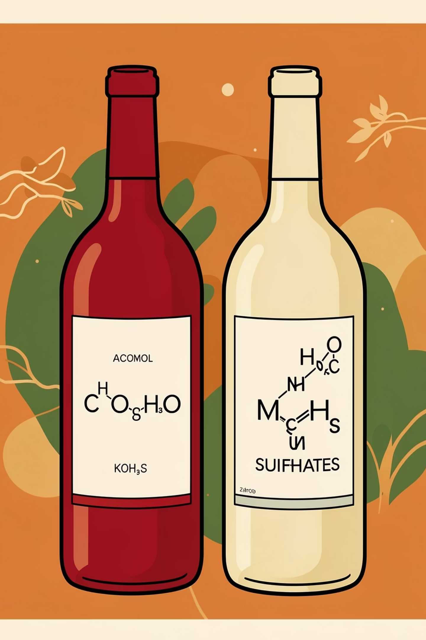
Top Associated Features with Quality score by Wine Type
Red Wine
White Wine
High Alcohol
High Sulphates
Low Volatile Acidity
Low Chlorides
High Citric Acid
High Alcohol
High pH
Low Density
Low Chlorides
Low Total Sulfur Dioxide

Slide 14
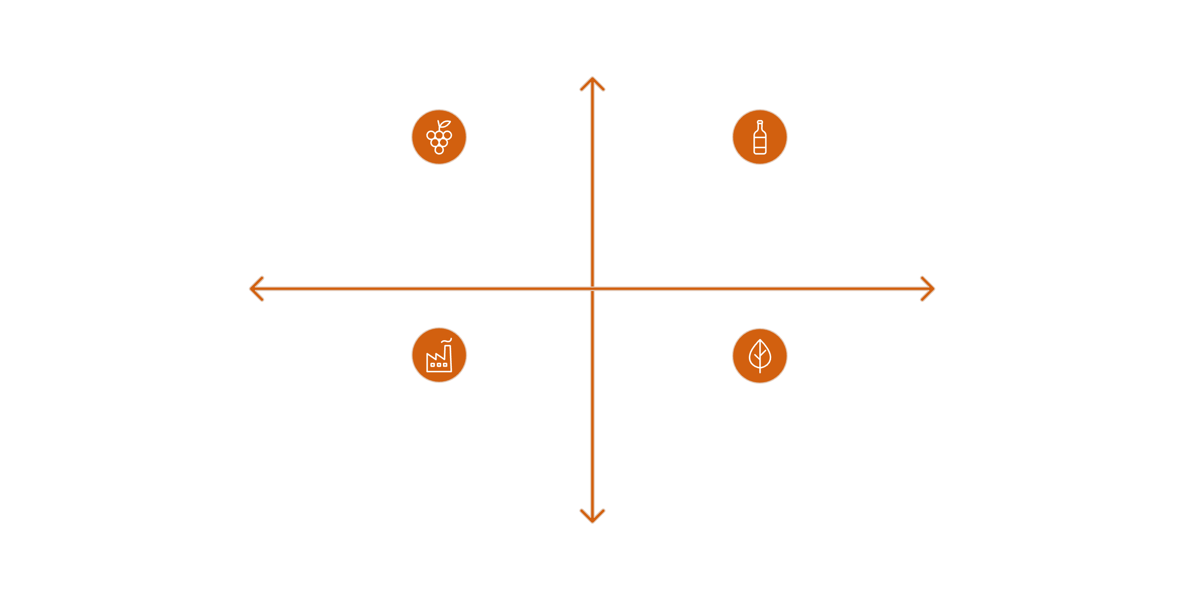




Dimensionality Reduction - PCA Interpretation
PC1 — Ripeness & Fermentation
PC2 — Processing/Stabilization
High alcohol, low density, high citric acid & sulphates, low volatile acidity → higher quality.
High sulfur dioxide, more residual sugar, higher density → processing/stability axis.
High Processing/Stabilization
High Processing/Stabilization
High Ripeness + High Processing
Low Ripeness
& Fermentation
High Ripeness
& Fermentation
Low Ripeness & Low Processing
High Ripeness & Fermentation
Low Processing/Stabilization
Wines with high PC1 and low PC2 consistently score higher.

Slide 15
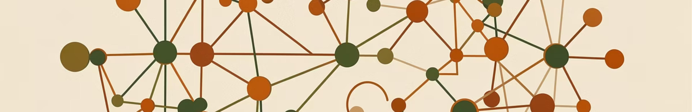
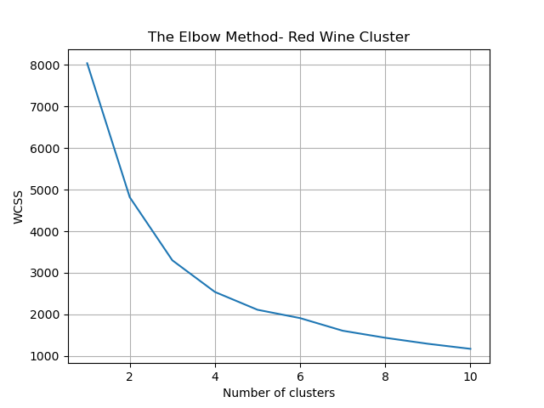
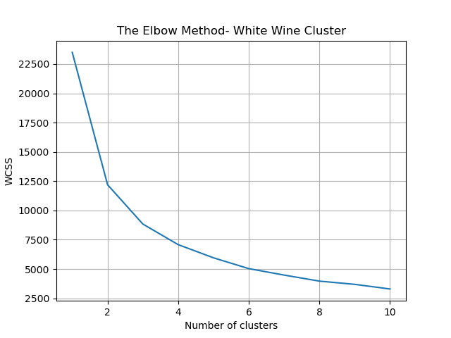


K-Means Clustering Methodology
To determine the optimal number of clusters for both the red and white wine datasets, unsupervised K-Means clustering analysis was conducted. This involved employing two widely recognized methods:
- Elbow method.
- Silhouette analysis.
Elbow Method
Silhouette Analysis
Identifies the "elbow point" in the WCSS curve where adding more clusters provides diminishing returns, indicating the optimal number of clusters.
Measures cluster cohesion and separation, with scores ranging from -1 to 1. Higher values indicate better-defined and well-separated clusters.

Slide 16
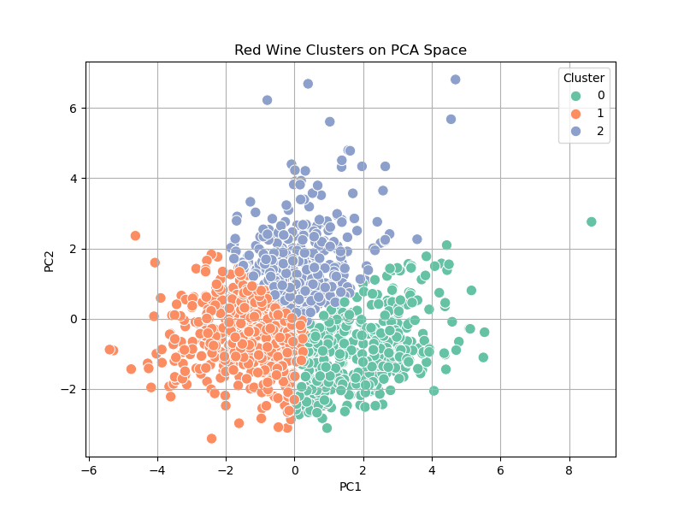
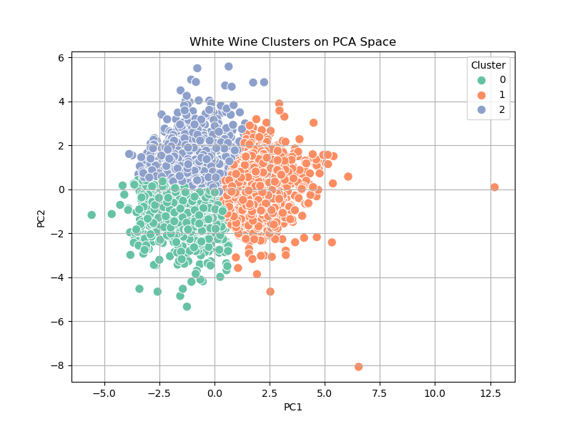
K-Means Clustering Results
Based on the Elbow method and silhouette analysis, 3 clusters were identified as optimal for both datasets.
Red Wine Clusters
White Wine Clusters
3 clusters with Silhouette Score of 0.377.
3 clusters with Silhouette Score of 0.378.
Red Wine Clusters Plot
White Wine Clusters Plot

Slide 17
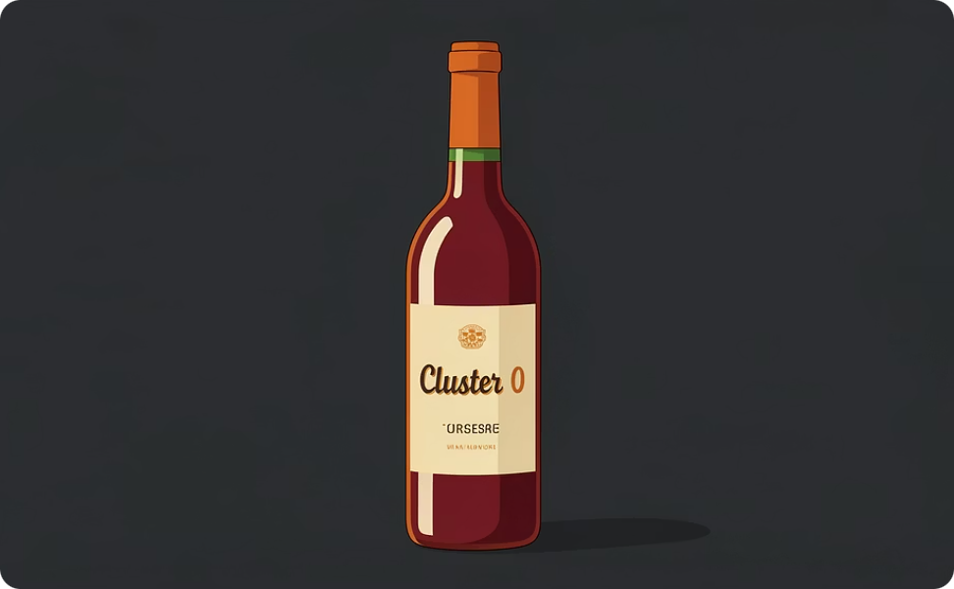
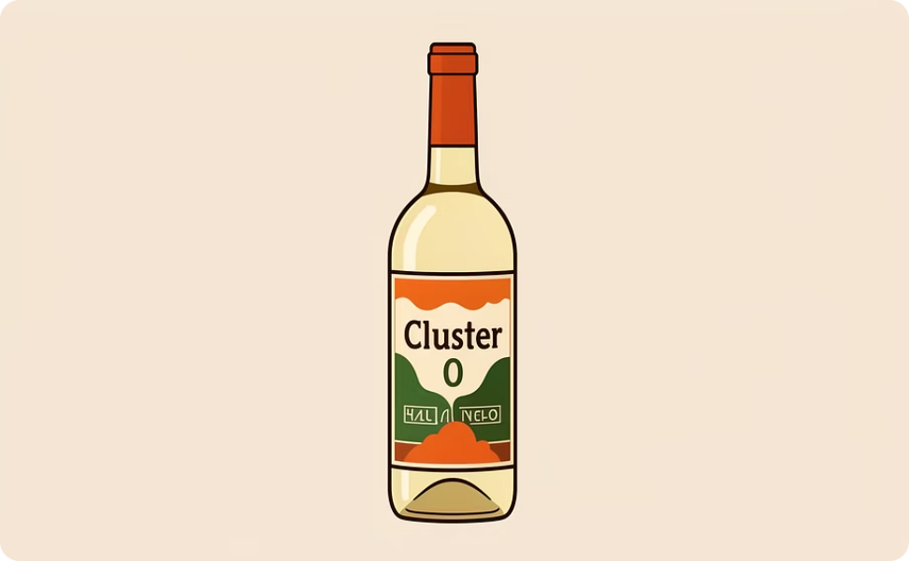
Cluster Benchmarks (Top Clusters)
Red Cluster #0
White Cluster #0
Highest mean score 5.95, and highest distribution of quality wines (score above 7) with 118 register samples. Benchmarks: Alcohol > 10.6%, Sulphates > 0.75 g/L, VA < 0.41 g/L, Chlorides < 0.10 g/L.
Highest mean score 6.17, and highest distribution of quality wines (score above 7) with 169 register samples. Benchmarks: Alcohol > 11.2%, Sulphates > 0.51 g/L, VA < 0.28 g/L, Chlorides < 0.04 g/L.

Slide 18
Actionable Chemical Targets
Practical thresholds derived from clusters 0 to guide winemaking decisions:
Variable
Red Benchmark
White Benchmark
Alcohol (%)
> 10.6
> 11.2
Sulphates (g/L)
> 0.75
> 0.51
Citric Acid (g/L)
> 0.48
> 0.28
Volatile Acidity (g/L)
< 0.41
< 0.28
Chlorides (g/L)
< 0.10
< 0.04
pH
> 3.18
> 3.31
Density
< 0.9978
< 0.9920
Total SO₂ (mg/L)
< 30
< 123
Residual Sugar (g/L)
< 2.6
< 3.4

Slide 19

Thank You
Thank you for your attention to this analysis. Your engagement and interest are greatly appreciated!
For a more detailed exploration of this analysis, please visit my GitHub repository: github.com/RenatoMateo
Contact Information
Name
Renato Silva
+971 58 506 5918.
rmsilvap@bu.edu
LinkedIn
linkedin.com/in/renato-silva-portilla/

